Slide 1
The Oncology Care Model at NMCC
Winter/Spring 2017
Barbara McAneny, MD

Slide 2
OCM is a Payer-Driven Model top-down approach
Payer-Driven
Payer identifies problem (oncology costs too high)
Payer changes reimbursement structure
Practices change
(or fail)

Slide 3
Oncology Care Model (OCM)
Patient Population:
The CMMI OCM Payment Model applies to all patients with a new chemotherapy start.
Episode Definition:
6 months following new chemotherapy start, repeatable.
Payments
The OCM model will pay physicians in three ways:
Normal FFS Payments
$160 PBPM (per beneficiary per month)
Shared Savings/Risk Sharing
Episode Price/Discount to Medicare
4% discount for practices participating in shared savings
2.75% discount for practices accepting full risk

Slide 4
COME HOME and OCM Comparison
COME HOME
OCM RFA
Hours of Operation/ After Hours Access/ Acute Appointments/ Phone System/ Triage System
Clinical Pathways
Biomarker Testing
Clinical Trials
Electronic Data Systems & Interoperability/ Data Availability and Timeliness of Data
Oncology Care Team
Patient Education
Total Cost of Care
Patient Satisfaction Surveys
Hospital/ ED Utilization
Hospice
Provide and Attest to 24/7 patient access to appropriate clinician who has real time access to practice’s EMR
Percentage of beneficiaries who are treated w/ therapies consist of nationally recognized clinical guidelines
OCM 24 Care Plan
Providing access to clinical trials
Attestation and use of ONC certified EHR’s are required
IOM’s 13-point Care Plan
Treatment benefits and harms, including common and rare toxicities and how to manage these toxicities, as well as short-term and late-term effects of treatment
Estimated total and out-of-pocket costs of cancer treatment to the patient
OCM 6- Patient reported experience of care
OCM 1 & 2- Risk adjusted proportion of patients w/ all-cause hospital admits w/in 6 mos episode and ED visits/ observation stays that did not result in hospital admissions
OCM 3- Proportion of patients who died that were admitted to hospice for 3 or more days

Slide 5
COME HOME and OCM Comparison
Hours of Operation/ After Hours Access/ Acute Appointments/ Phone System/ Triage System
Biomarker Testing/ Clinical Trials/ Electronic Data Systems & Interoperability/ Data Availability and Timeliness of Data
Oncology Care Team/ Patient Education/ Patient Satisfaction Surveys
Total Cost of Care/ Hospital and ED Utilization/ Hospice
Clinical Pathways
Provide and Attest to 24/7 Patient Access to appropriate clinician w/ real time access to practice’s EMR
IOM’s 13-point Care Plan/ OCM 6- Patient reported experience of care
OCM 1 & 2- Risk adjusted proportion of patients w/ all-cause hospital admits w/in 6 mos episode and ED visits/observation stays that did not result in hospital admissions
OCM 3- Proportion of patients who died that were admitted to hospice for 3 or more days
OCM 24 Care Plan/ Providing Access to Clinical Trials/ Attestation and use of ONC certified EHR’s required
% of beneficiaries treated w/ therapies consistent of nationally recognized clinical guidelines

Slide 6
Practice Redesign

Slide 7
Meeting OCM requirements and adding Value
Efficient use of personnel
Documentation of OCM requirements using minimal resources
Can we turn the Care plan and survivorship documents into valuable features to patients?
Will the entire MEOS payment be used in the processes to achieve it?

Slide 8
Meeting OCM requirements and adding Value
Efficient use of personnel
Documentation of OCM requirements using minimal resources
Can we turn the Care plan and survivorship documents into valuable features to patients?
Will the entire MEOS payment be used in the processes to achieve it?

Slide 9
Everyone works to the top of their license
Physician
Undefined or overlapping workflows
Physician
APP
APP
License
Nursing
Nursing/Triage/Case Mgt.
Administration /
Clerical
Administrative & Clerical
Defined, efficient workflows
Standardized protocols & good communication
Notes:
COME HOME prepared us for OCM
Education, Education, Education – Agenda item at every meeting in the organization
Cultural change – change in thought process . Care of the whole pt --not just the disease
Important to define roles of all staff
Starts from the beginning – Centralizing Pt intake process into the practice – 9 sites, 20 docs (14 med oncs), 8 APs
Operators – centralized to control flow of calls – triaging the call direction
DRs- Pathways (clinical pathways an integral component of the patient care process) and acute care slots
Pt flow and expectations --- pt education from the first visit!!!!
New Metrics of Success:
Minimizing ER and Inpatient Services – Avoiding admissions a new benchmark
Coordinating all parts with all providers – PCP, other specialists
Decrease duplicate services
***Concrete examples of how we worked to top of license
Navigators – Advance Directives
Patient Education
Advanced Practitioners – Survivorship
Bone Marrow Clinic
Acute Care Visits
Oral Chemo Teaching
Nursing - Triage – nurse assessment by braille
Independent decision making regarding scheduling patients, solving acute issues, etc
Administration – Operators triaging calls for distribution
Mgt. Team driving the changes in infrastructure and overall culture.

Slide 10
Specialization within oncology nursing and non-clinical staff
Non-clinical front office staff
Oncology Nursing
Check-in/check out
Phone Operators
Patient Care Coordinators
Navigation
Infusion
Care Management
Triage
OCM Required Navigation Activities

Slide 11
Meeting OCM requirements and adding Value
Efficient use of personnel
Documentation of OCM requirements using minimal resources
Can we turn the Care plan and survivorship documents into valuable features to patients?
Will the entire MEOS payment be used in the processes to achieve it?

Slide 12
Documentation
Essential functions to be documented by the doctors
DIAGNOSIS
STAGING
INTENT OF THERAPY (includes outcomes expected)
PERFORMANCE STATUS & PE
CHEMOTHERAPY & TEST ORDERS
GENOMICS
Can we have everything else done by others?

Slide 13
Meeting OCM requirements and adding Value
Efficient use of personnel
Documentation of OCM requirements using minimal resources
Can we turn the Care plan and survivorship documents into valuable features to patients?
Will the entire MEOS payment be used in the processes to achieve it?

Slide 14
Care Plan Requirements
Patient information (e.g., name, date of birth, medication list, and allergies)
Diagnosis, including specific tissue information, relevant biomarkers, and stage
Prognosis
Treatment goals (curative, life-prolonging, symptom control, palliative care)
Initial plan for treatment and proposed duration, including specific chemotherapy drug names, doses, and schedule as well as surgery and radiation therapy (if applicable)
Expected response to treatment
Treatment benefits and harms, including common and rare toxicities and how to manage these toxicities, as well as short-term and late effects of treatment
Information on quality of life and a patient’s likely experience with treatment
Who will take responsibility for specific aspects of a patient’s care (e.g., the Cancer care team, the primary care/geriatrics care team, or other care teams)
Advance care plans, including advanced directives and other legal documents
Estimated total and out-of-pocket costs of Cancer treatment
A plan for addressing a patient’s psychosocial health needs, including psychological, vocational, disability, legal, or financial concerns and their management
Survivorship plan, including a summary of treatment and information on recommended follow-up activities and surveillance, as well as risk reduction and health promotion activities

Slide 15
History

Slide 16
Treatment

Slide 17
Surgery

Slide 18
Side Effects of Treatment

Slide 19
Review of Systems

Slide 20
Physical Exam

Slide 21
Follow up/Referrals

Slide 22
Assessment Plan

Slide 23
Financial Outcomes

Slide 24
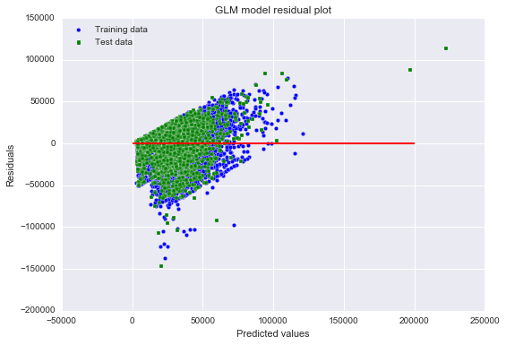
OCM model performance evaluated on the
subset of episodes:
R^2 = .334
Construct our own GLM and split the data into training and test sets:
R^2 train:
.300
R^2 test:
.280

Slide 25
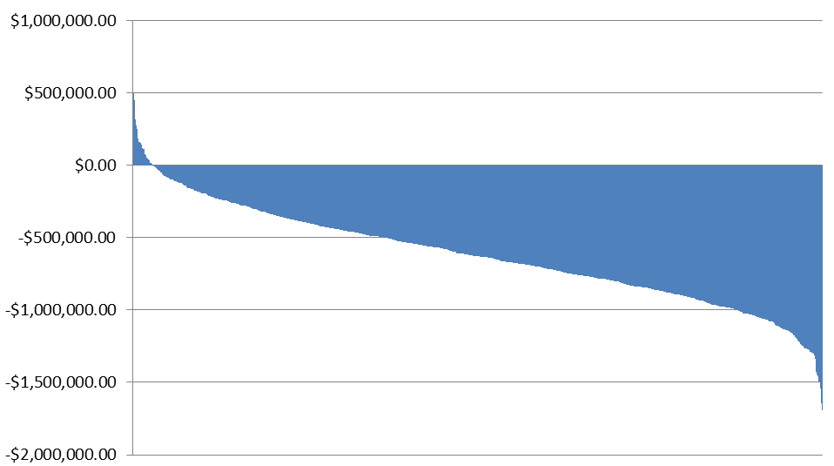
Simulated NMCC Performance-Based Payments – OCM Full Risk
1,000 simulated Performance Periods using baseline prices and actual expenses from NMCC, to include NMCC case mix and practice patterns. According to these simulations, NMCC will see a shared savings payment in 37 out of 1,000 Performance Periods (3.7%)

Slide 26
Aggregate (Performance Period) Cost Modeling – Shared Savings
Average Performance Period Actual Expenses | $6,845,238
Average Performance Period Baseline Price | $6,620,624
Average Performance Period Shared Savings Target | $6,355,790
MEOS Payments per Performance Period | $228,480
Savings needed to achieve Shared Savings PBP ($) | $717,928
Savings needed to achieve Shared Savings PBP (%) | 10.5%
$$Savings to achieve PBP=\left(Actual Expenses −Target\right)+MEOS$$
$$Savings to achieve PBP=\left(\$6,845,238−\$6,355,790\right)+\$228,480$$
$$Savings to achieve PBP=\$489,448+\$228,480$$
$$Savings to achieve PBP=\$717,928 (10.5\%)$$

Slide 27
Aggregate (Performance Period) Cost Modeling – Full Risk
Average Performance Period Actual Expenses | $6,845,238
Average Performance Period Baseline Price | $6,620,624
Average Performance Period Full Risk Target | $6,438,614
MEOS Payments per Performance Period | $228,480
Savings needed to achieve Shared Savings PBP ($) | $635,104
Savings needed to achieve Shared Savings PBP (%) | 9.3%
$$Savings to achieve PBP=\left(Actual Expenses −Target\right)+MEOS$$
$$Savings to achieve PBP=\left(\$6,845,238−\$6,620,624\right)+\$228,480$$
$$Savings to achieve PBP=\$406,624+\$228,480$$
$$Savings to achieve PBP=\$635,104 (9.3\%)$$

Slide 28
Baseline vs. Actual by Cancer Type blue > red = practice losing money

Slide 29
Baseline vs. Actual by Cancer Type blue > red = practice losing money

Slide 30
Baseline vs. Actual by Cancer Type blue > red = practice losing money

Slide 31
Baseline vs. Actual by HCC Score blue > red = practice losing money

